Slide 1
Agricultural Transformation and the Emergence of Cities and States
Early Human Societies
Agricultural Transformation
Emergence of Cities and States

Slide 2
Early Human Societies
Stone Age
  Neolithic
Hunter and Gatherer Society
Development of Culture

Slide 3
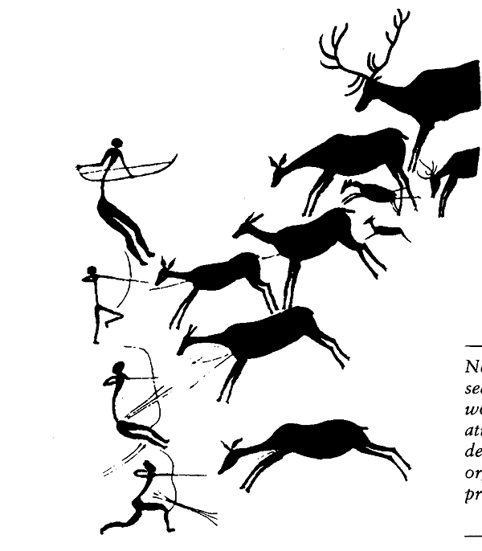
Neolithic Cave Painting

Slide 4
Agricultural Transformation
What prompted the need for agricultural development?
New techniques used in agriculture
Spread of farming
Animal Domestication

Slide 5
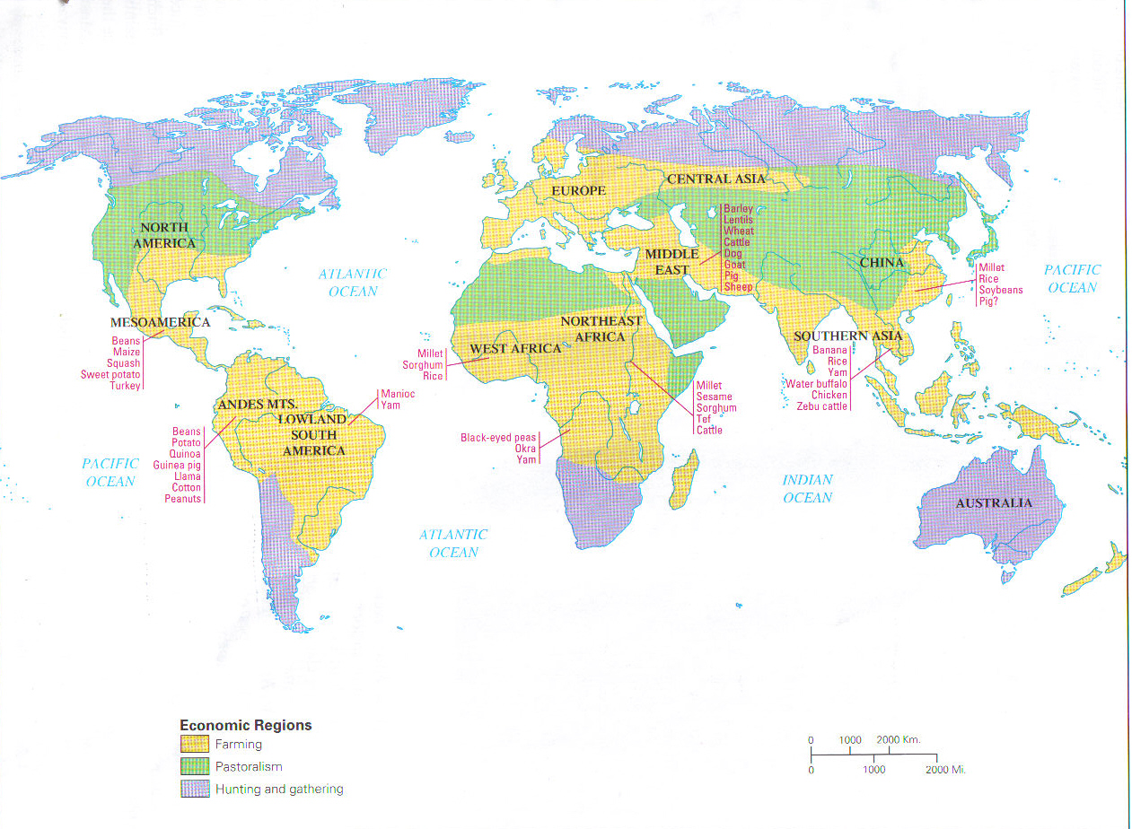

Slide 6
Emergence of Cities and States
Metalworking
Development of ‘Towns’
  Çatal Hüyük
Urbanization
Formation of states

Slide 7
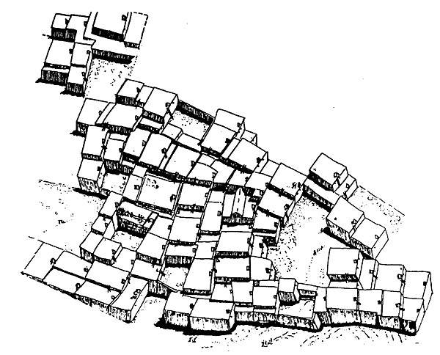
Çatal Hüyük
(c. 6800 B.C.E.)

Slide 8
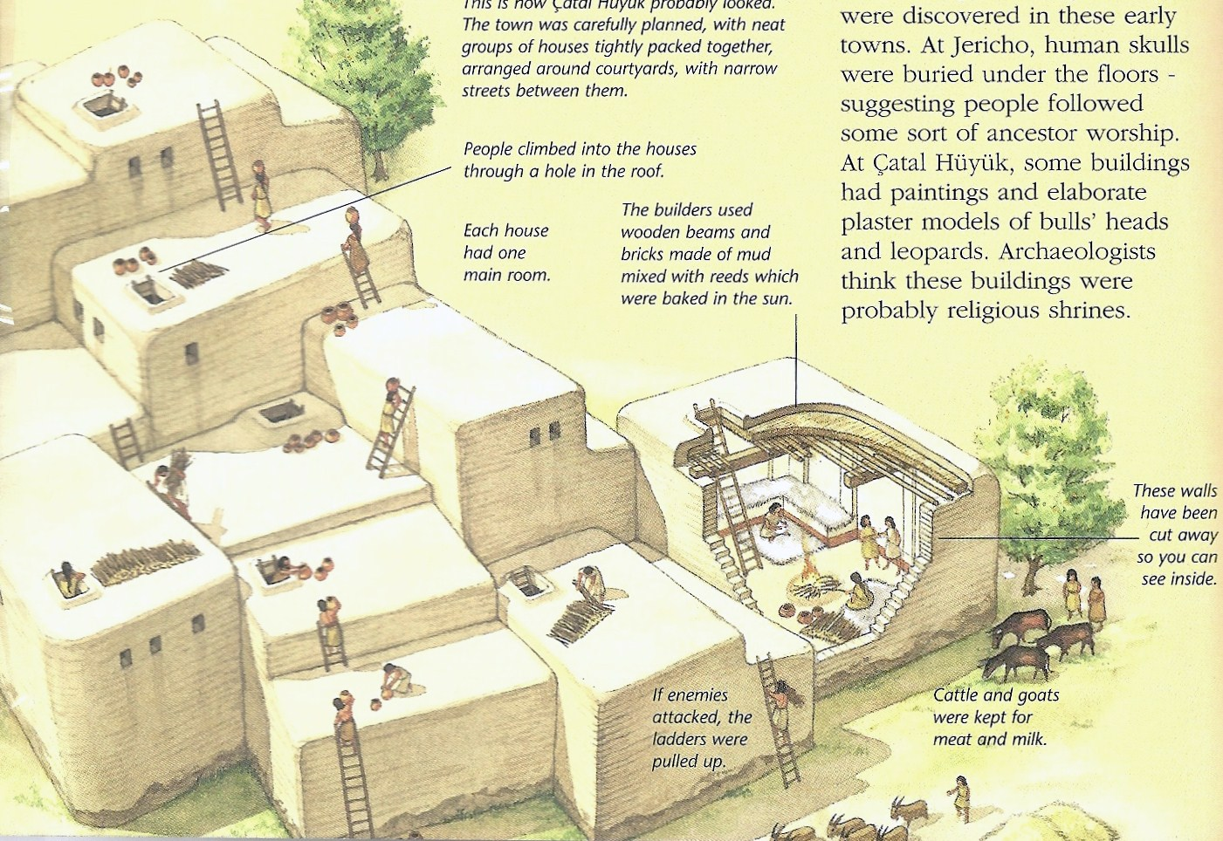

Slide 9
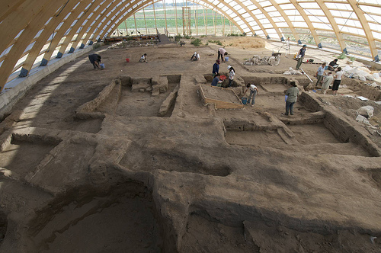
Çatal Hüyük
(Today)

Slide 10
